Slide 1


Akshatha G 4VM23CS001 Mahesh S 4VM23CS033
S Mohammed Maaz 4VM23CS043
Syeda Umme Haani 4VM23CS055
Vidya Vikas Institute of Engineering & Technology, Mysuru
Department of Computer Science and Engineering
Project on
AI POWERED AUTONOMOUS COCONUT HARVESTING SYSTEM
PRESENTED BY
Under the guidance of
Dr. Madhu B K
Dean Of CSE
VVIET

Slide 2
Vidya Vikas Institute of Engineering and Technology, Mysuru
Department of Computer Science and Engineering
CONTENTS
Introduction
Problem Statement
Objectives
Software and Hardware Requirements
Methodology
Flow Chart
Work Carried out so far
Result
References

Slide 3
Vidya Vikas Institute of Engineering and Technology, Mysuru
Department of Computer Science and Engineering
INTRODUCTION
AI Powered Autonomous Coconut Harvesting System is an AI-powered Digital Twin platform that transforms drone surveys into a live virtual model of a coconut plantation. It uses YOLOv8-based detection to identify trees and coconut ripeness, plans optimal harvesting routes, and simulates an autonomous harvesting robot in real time..

Slide 4
Vidya Vikas Institute of Engineering and Technology, Mysuru
Department of Computer Science and Engineering
Problem Statement
Coconut harvesting in India still depends on manual tree climbing, which is risky, labour-intensive, and costly due to the shortage of skilled workers. Farmers also face difficulties in identifying mature coconuts and managing harvesting efficiently on large plantations, leading to reduced productivity and crop loss.

Slide 5
Vidya Vikas Institute of Engineering and Technology, Mysuru
Department of Computer Science and Engineering
Objectives
To detect and map coconut trees from drone imagery using AI-based detection and GPS localisation.
To identify coconut ripeness and maintain an up-to-date per-tree coconut inventory.
To plan and manage harvesting missions through preference-based robot-executable routes and task queues.
To provide a centralized dashboard for digital twin visualization, mission tracking, tree details, history, and analytics.

Slide 6
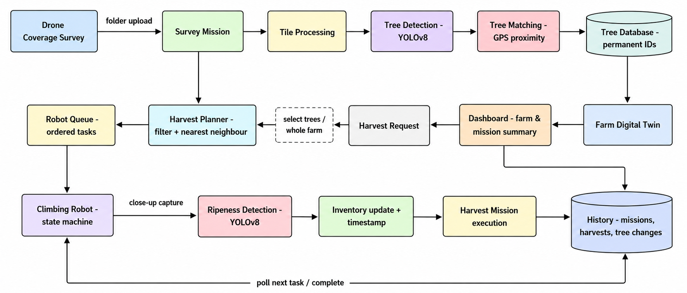
Vidya Vikas Institute of Engineering and Technology, Mysuru
Department of Computer Science and Engineering
Methodology

Slide 7
Vidya Vikas Institute of Engineering and Technology, Mysuru
Department of Computer Science and Engineering
Software and Hardware Requirements
Software Requirements
Backend – Python, FastAPI, Uvicorn, SQLAlchemy, PostgreSQL (Neon), and python-dotenv for configuration management.
AI / Computer Vision – Ultralytics YOLOv8 for coconut tree and ripeness detection, with local YOLO model weights.
Frontend – Next.js 16, React 19, TypeScript, and Tailwind CSS for the Digital Twin, dashboard, and robot visualization.
Simulation & Communication – Python-based time-driven robot simulation with Simulation Engine, Simulation Clock, Scheduler, and WebSocket-based telemetry.
Development Tools – Git/GitHub for version control, VS Code for development, and npm for frontend package management.
Hardware Requirements
Development Computer – Laptop/Desktop capable of running the Next.js frontend, FastAPI backend, PostgreSQL connectivity, and YOLOv8 inference.
Camera / Image Source – Aerial and close-up coconut plantation images for tree detection and ripeness inspection.
GPU (Recommended) – Dedicated GPU recommended for faster YOLOv8 model inference and image processing.
Internet Connection – Required for accessing the PostgreSQL database hosted on Neon and other development/deployment services.

Slide 8
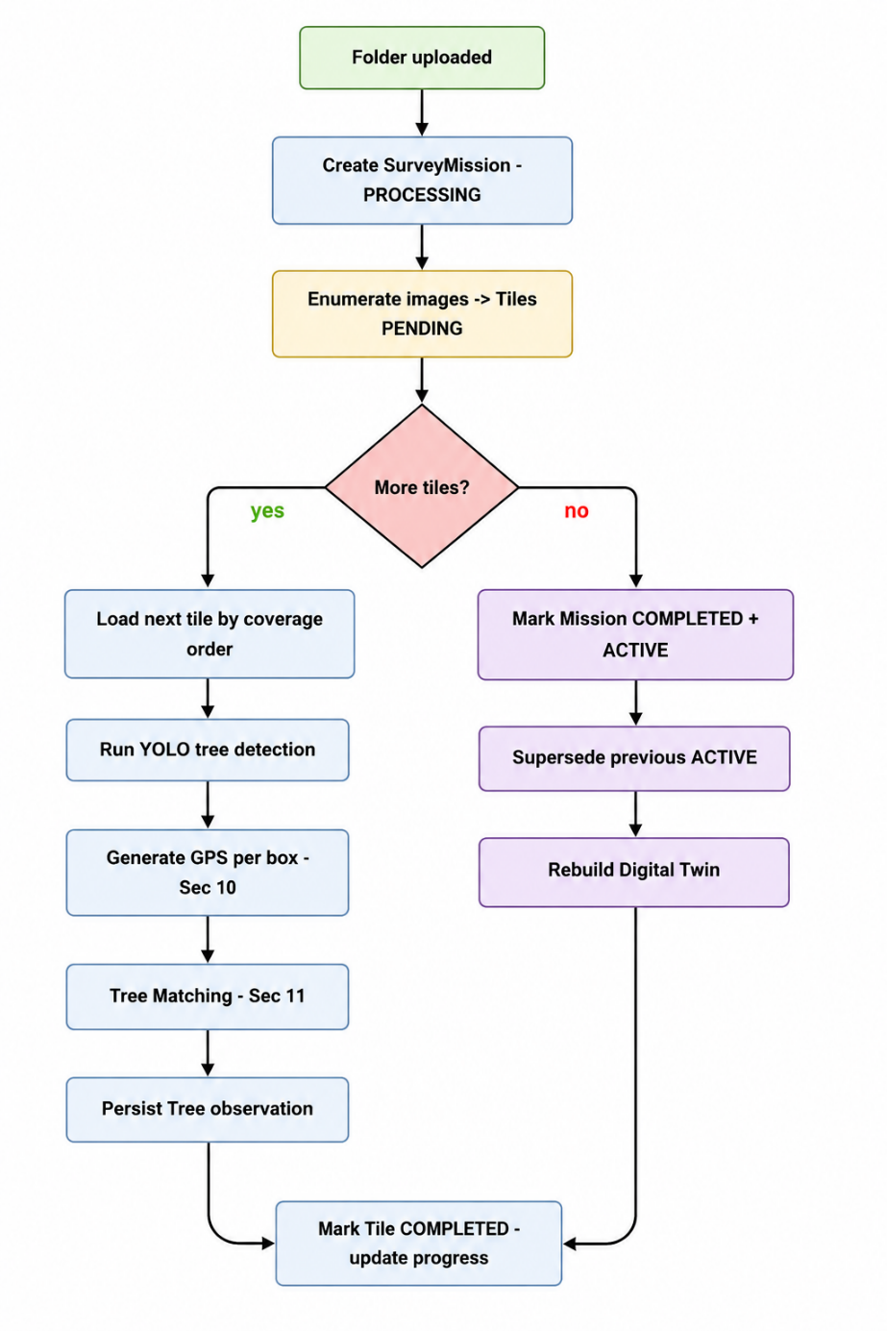
Vidya Vikas Institute of Engineering and Technology, Mysuru
Department of Computer Science and Engineering
Flow Chart

Slide 9
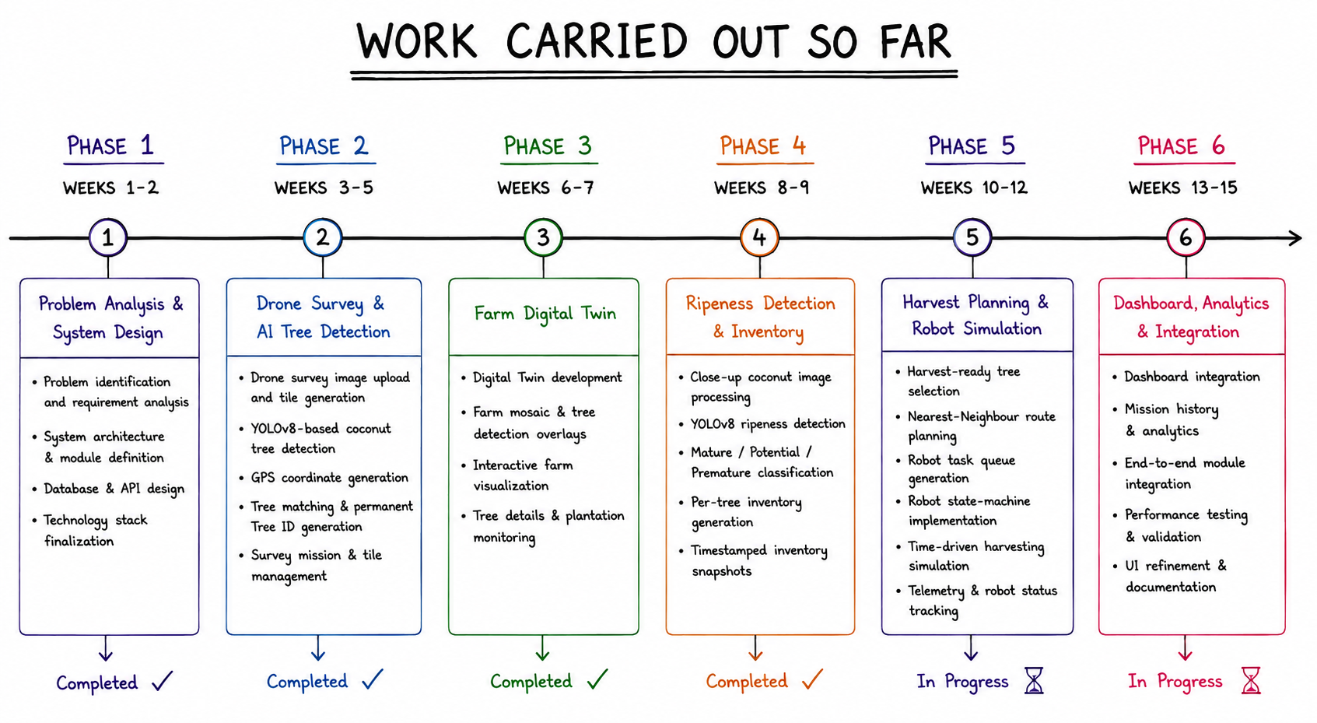
Vidya Vikas Institute of Engineering and Technology, Mysuru
Department of Computer Science and Engineering

Slide 10
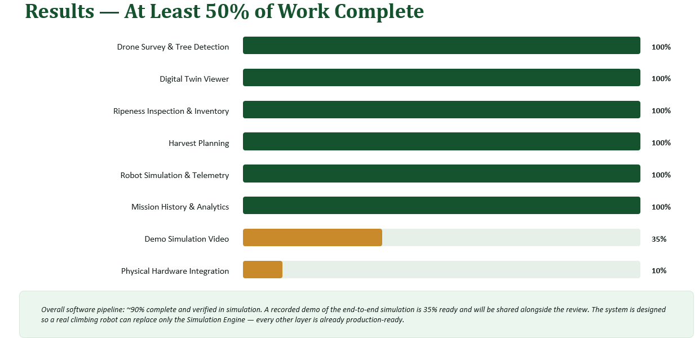

Vidya Vikas Institute of Engineering and Technology, Mysuru
Department of Computer Science and Engineering
Result

Slide 11
Vidya Vikas Institute of Engineering and Technology, Mysuru
Department of Computer Science and Engineering
References
Wibowo, S. et al. (2016). Autonomous Coconut Harvesting Robot. — End-to-end robotic system with climbing and fastening mechanism for coconut plantations. https://www.scribd.com/document/910220402/wibowo2016
Rathod, A. et al. (2016). Autonomous Control and Implementation of Coconut Tree Climbing and Harvesting Robot. Procedia Computer Science, Elsevier.sciencedirect
Amrita University (2015). Prototype of a Coconut Harvesting Robot with Visual Feedback. Advances in Intelligent Systems and Computing, Springer India.amrita
IOSR Journal of Engineering (2025). Coconut Harvest Mechanization Robot (CHMR) — Autonomous Device for Optimizing Coconut Harvesting. Vol. 15, Issue 1.iosrjen
Journal of Engineering and Applied Innovation (2023). Status and Scope of Automated Coconut Harvester in India. JEAI.journaljeai
JOUAV (2023). Agriculture Drones — Farming Drone for Crop Monitoring and Precision Farming. jouav.com, October 2023.jouav

Slide 12
Vidya Vikas Institute of Engineering and Technology, Mysuru
Department of Computer Science and Engineering
References
International Journal of Advanced Computer Science and Applications (2023). Detection of Fruit using YOLOv8-based Single Stage Object Detection for Precision Agriculture. IJACSA, Vol. 14, Issue 12.thesai
Nature Scientific Reports (2024). YOLOv8-CML: A Lightweight Target Detection Method for Intelligent Agriculture. Nature, 2024.nature
Frontiers in Plant Science (2025). RLK-YOLOv8: Multi-Stage Detection of Fruits Using Improved YOLOv8. Frontiers, Vol. 16.frontiersin
CGIAR (2025). From Sky to Soil: How Drones are Revolutionizing Crop Monitoring. CGIAR Research, March 2025.cigar
Journal of Agricultural and Crop Research (2025). Optimizing Crop Monitoring Efficiency and Precision with Drone Technology. ACRI, 2025.journalacri
Equinox Drones (2024). Agriculture Drones for Precision Farming — UAV Aerial Imagery with Machine Learning. equinoxsdrones.com, 2024.equinoxsdrones

